Slide 1
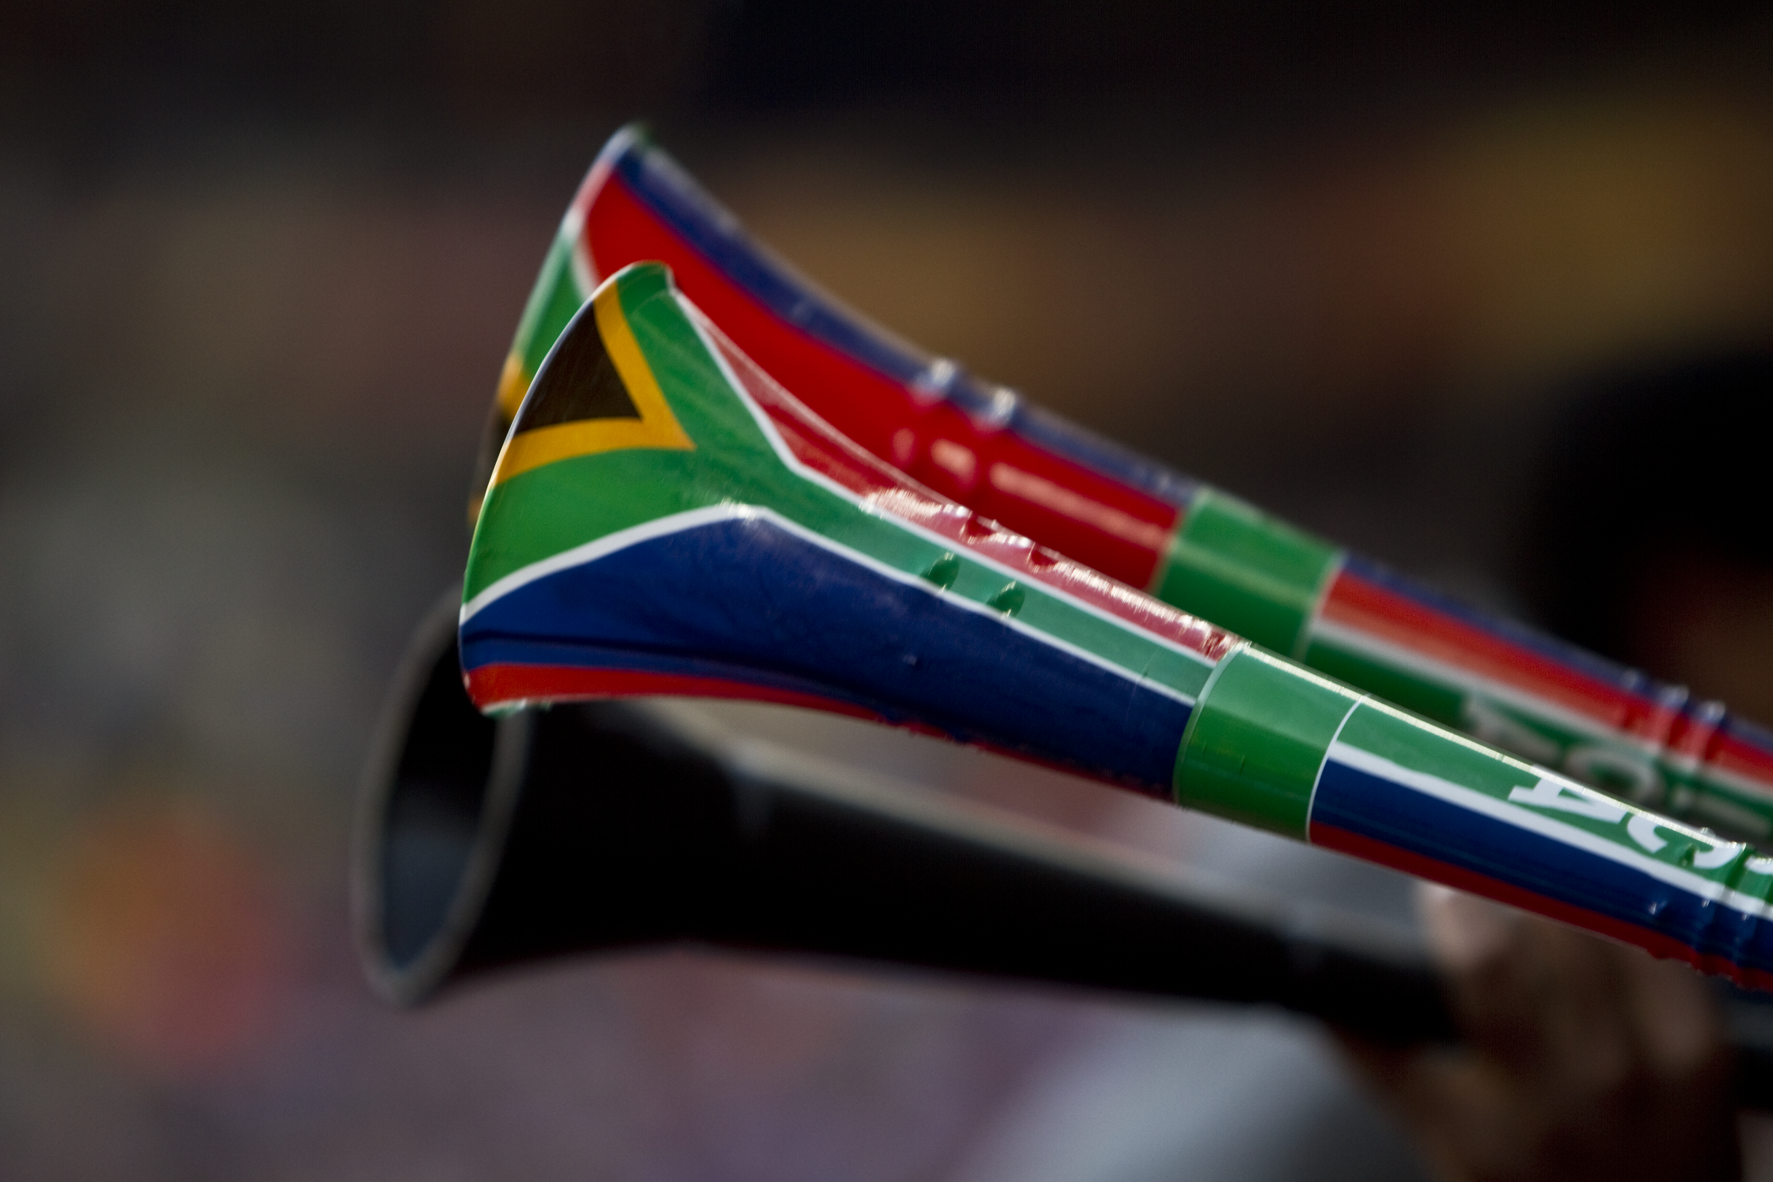
SPORTS IMPACT
FIFA WORLD CUP

Slide 2
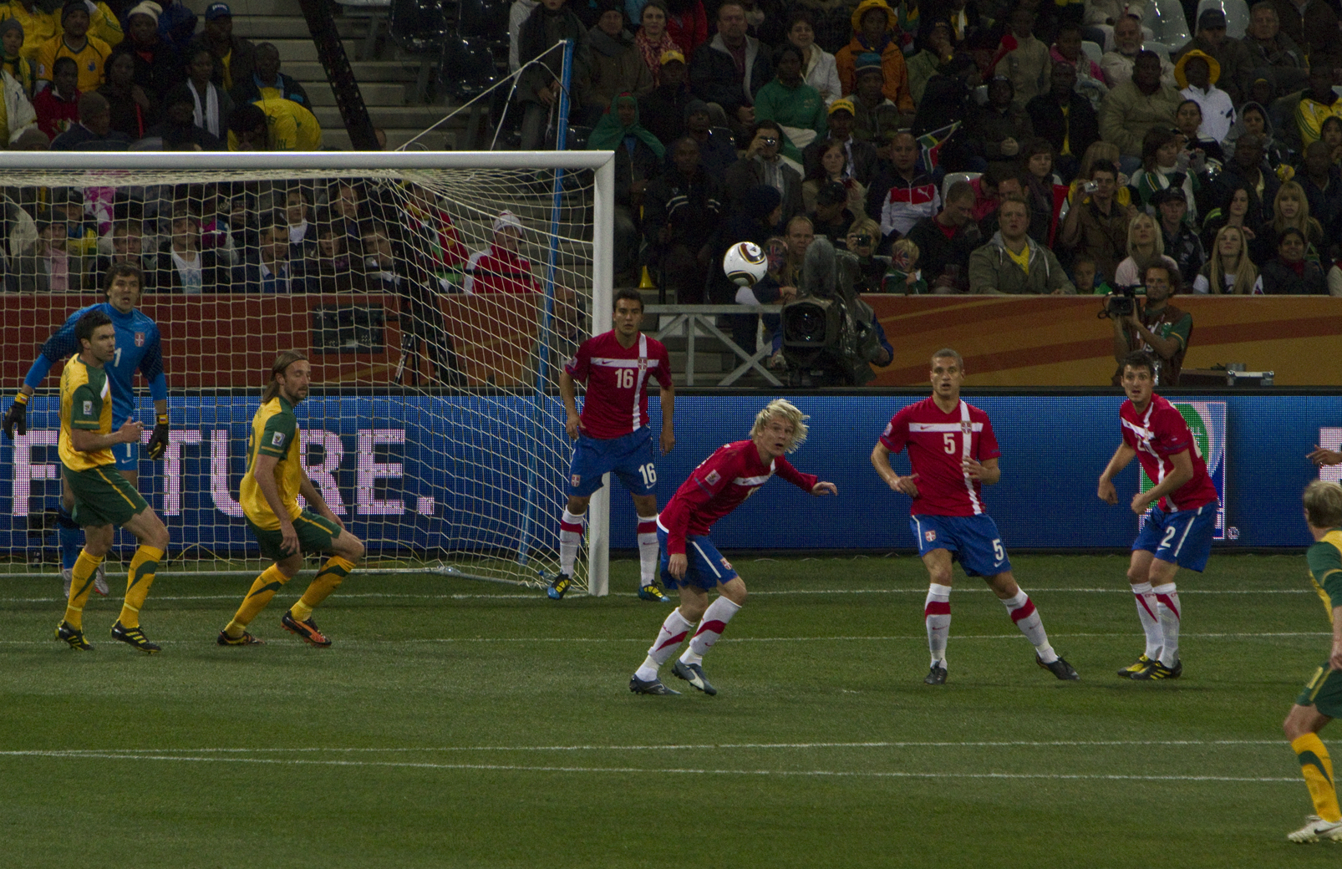
Overview of ministry
  South Africa
  15 June – 3 July 2010
    Week 2 of group stage through the first of the quarterfinals.
19 days

Slide 3
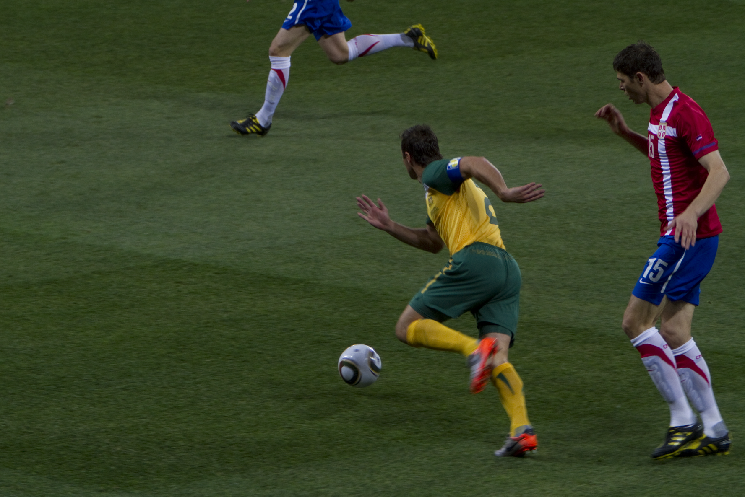
Overview of ministry
19 days
13 games worked
  We were privileged to attend 7

Slide 4
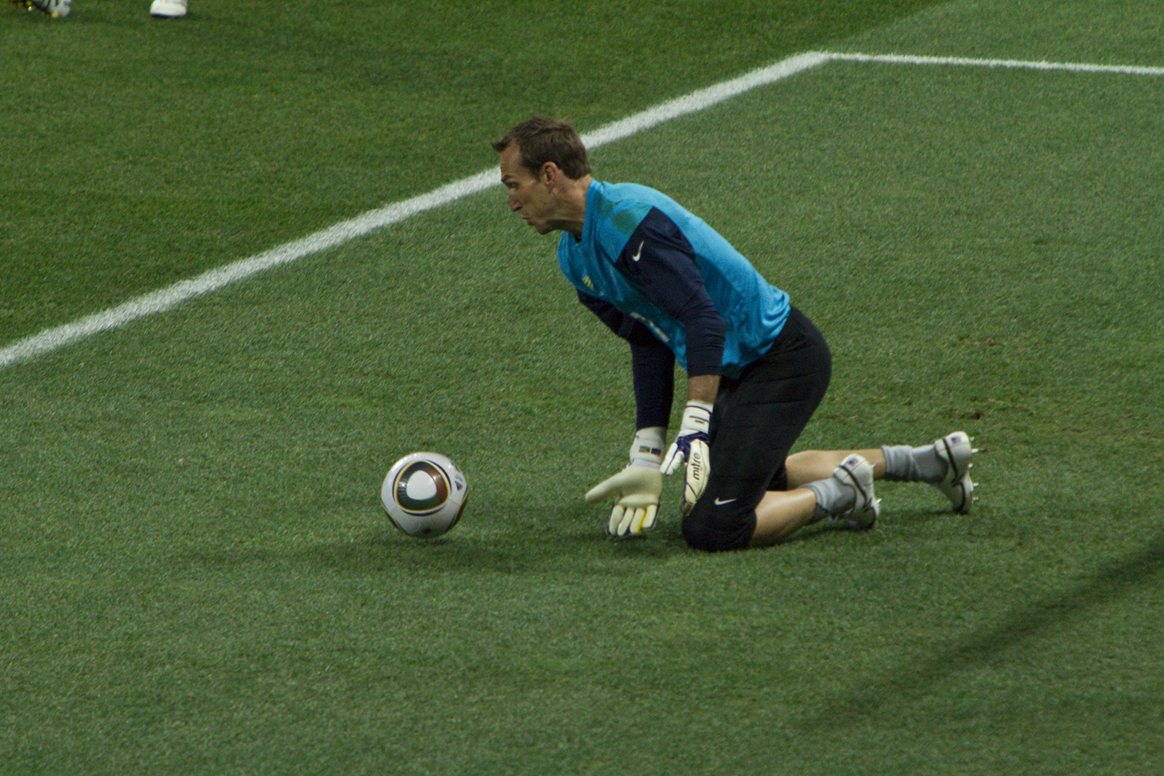
Overview of ministry
19 days
13 games worked
Over 9100 tracts personally distributed
  Over 23,000 of our tracts, and over 235,000 by evangelicals are out!

Slide 5
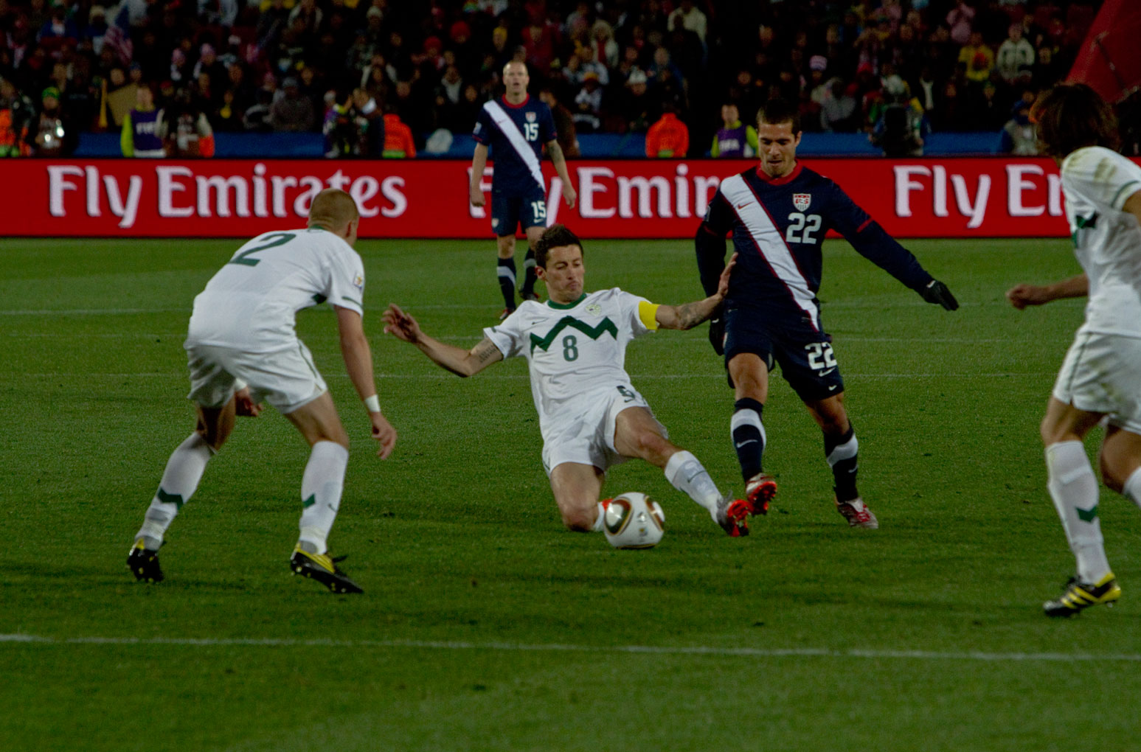
Overview of ministry
19 days
13 games worked
Over 9100 tracts personally distributed
5327 Kilometers traveled to 6 stadiums

Slide 6
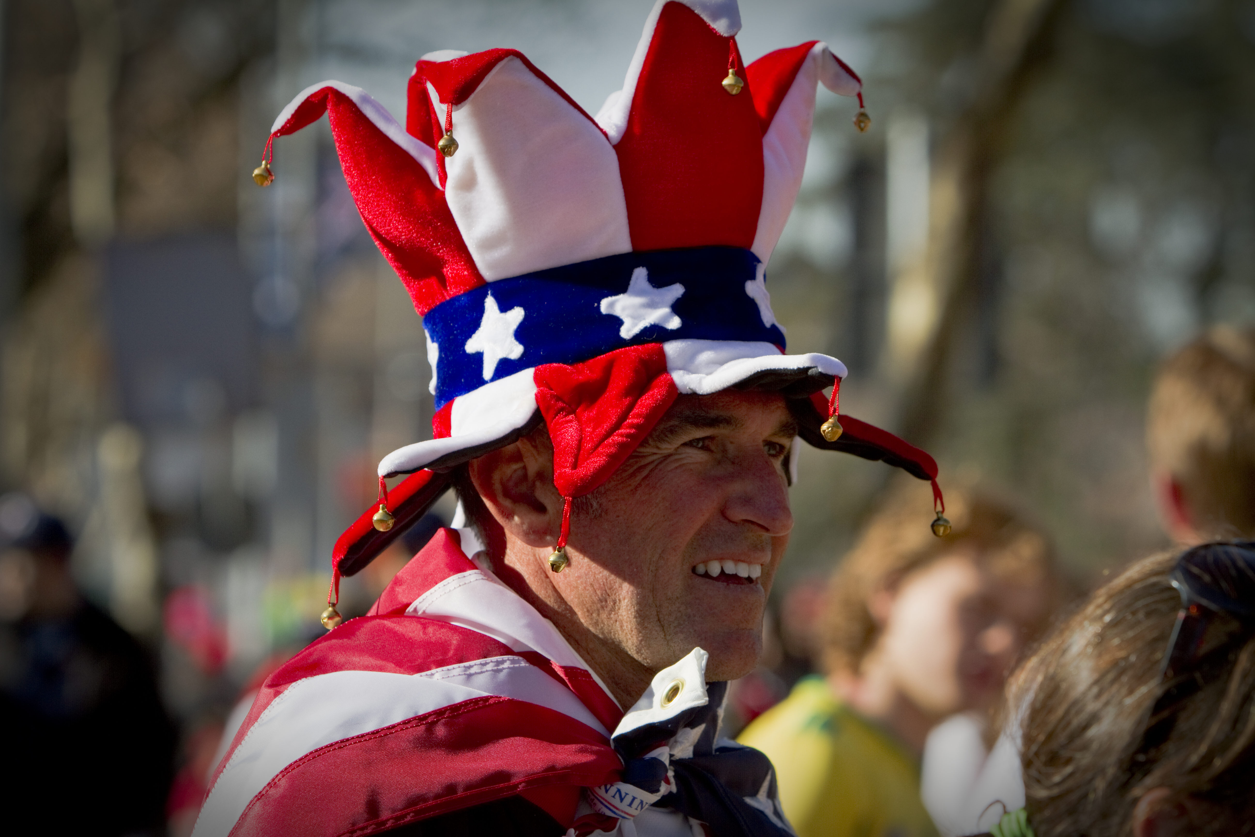
Focus of Sports Impact
Sharing the Gospel of Jesus Christ with Sports Fans
  We know of 6 who have already accepted Christ as Saviour!

Slide 7
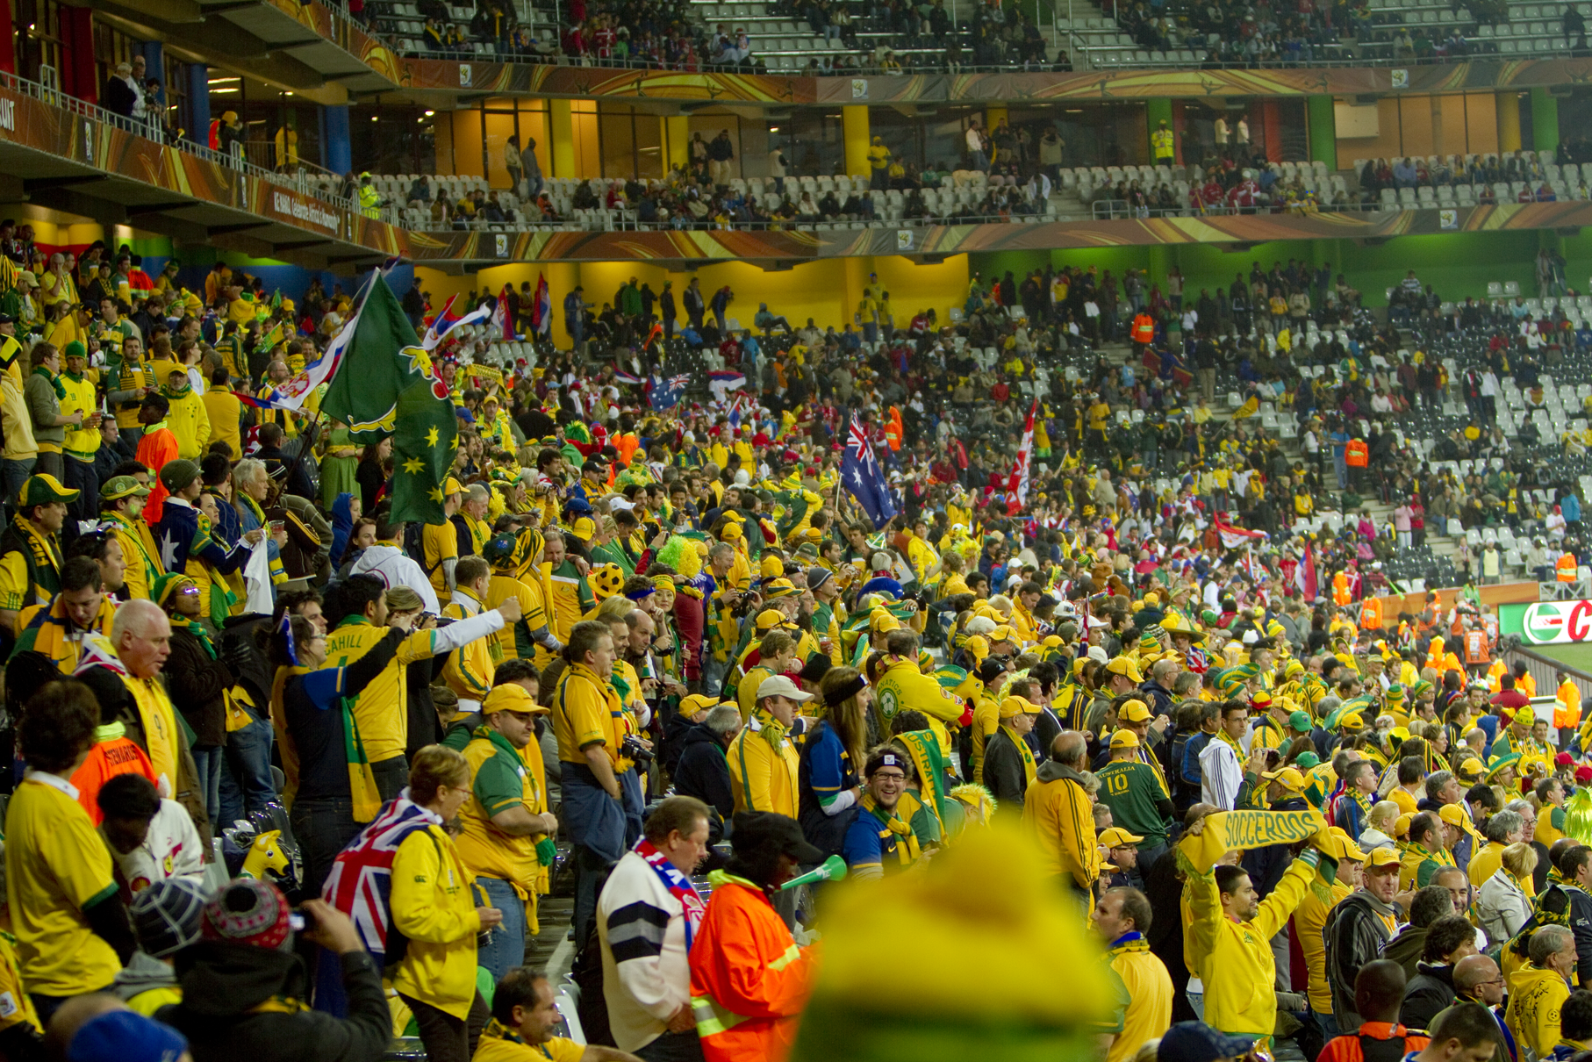
Focus of Sports Impact
Sharing the Gospel of Jesus Christ with Sports Fans
Ministering through tract distribution and spoken gospel presentations

Slide 8
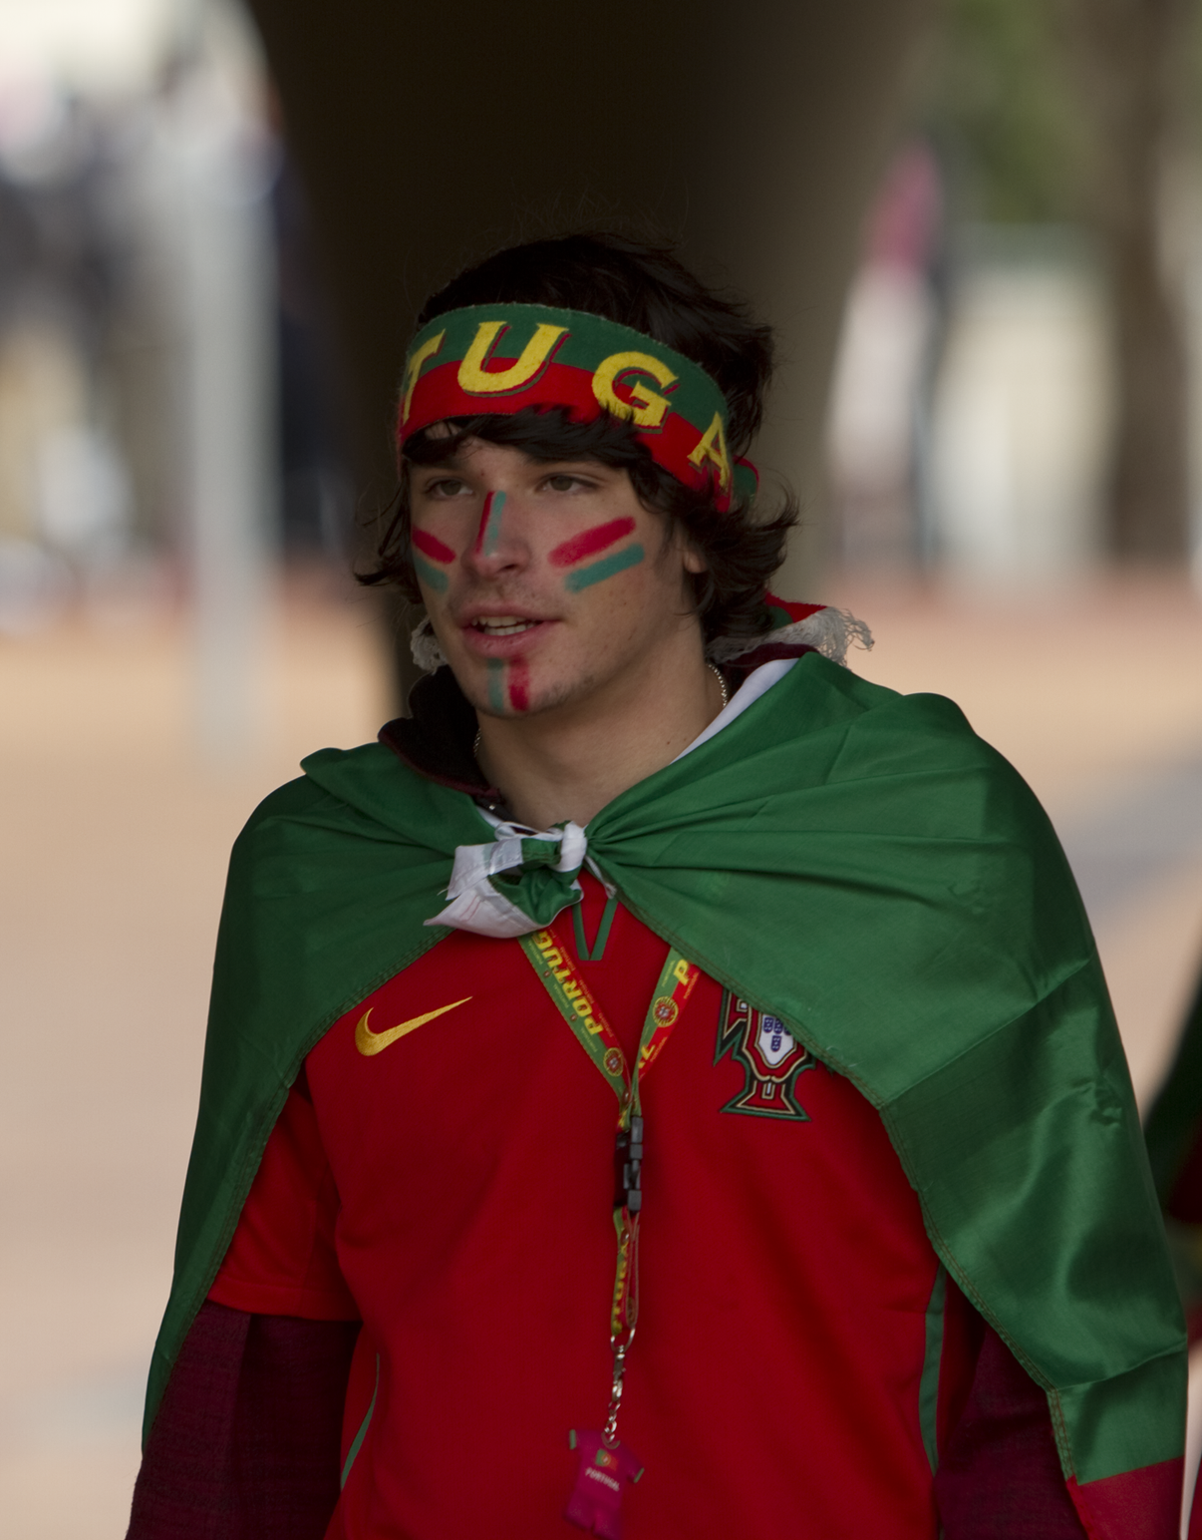
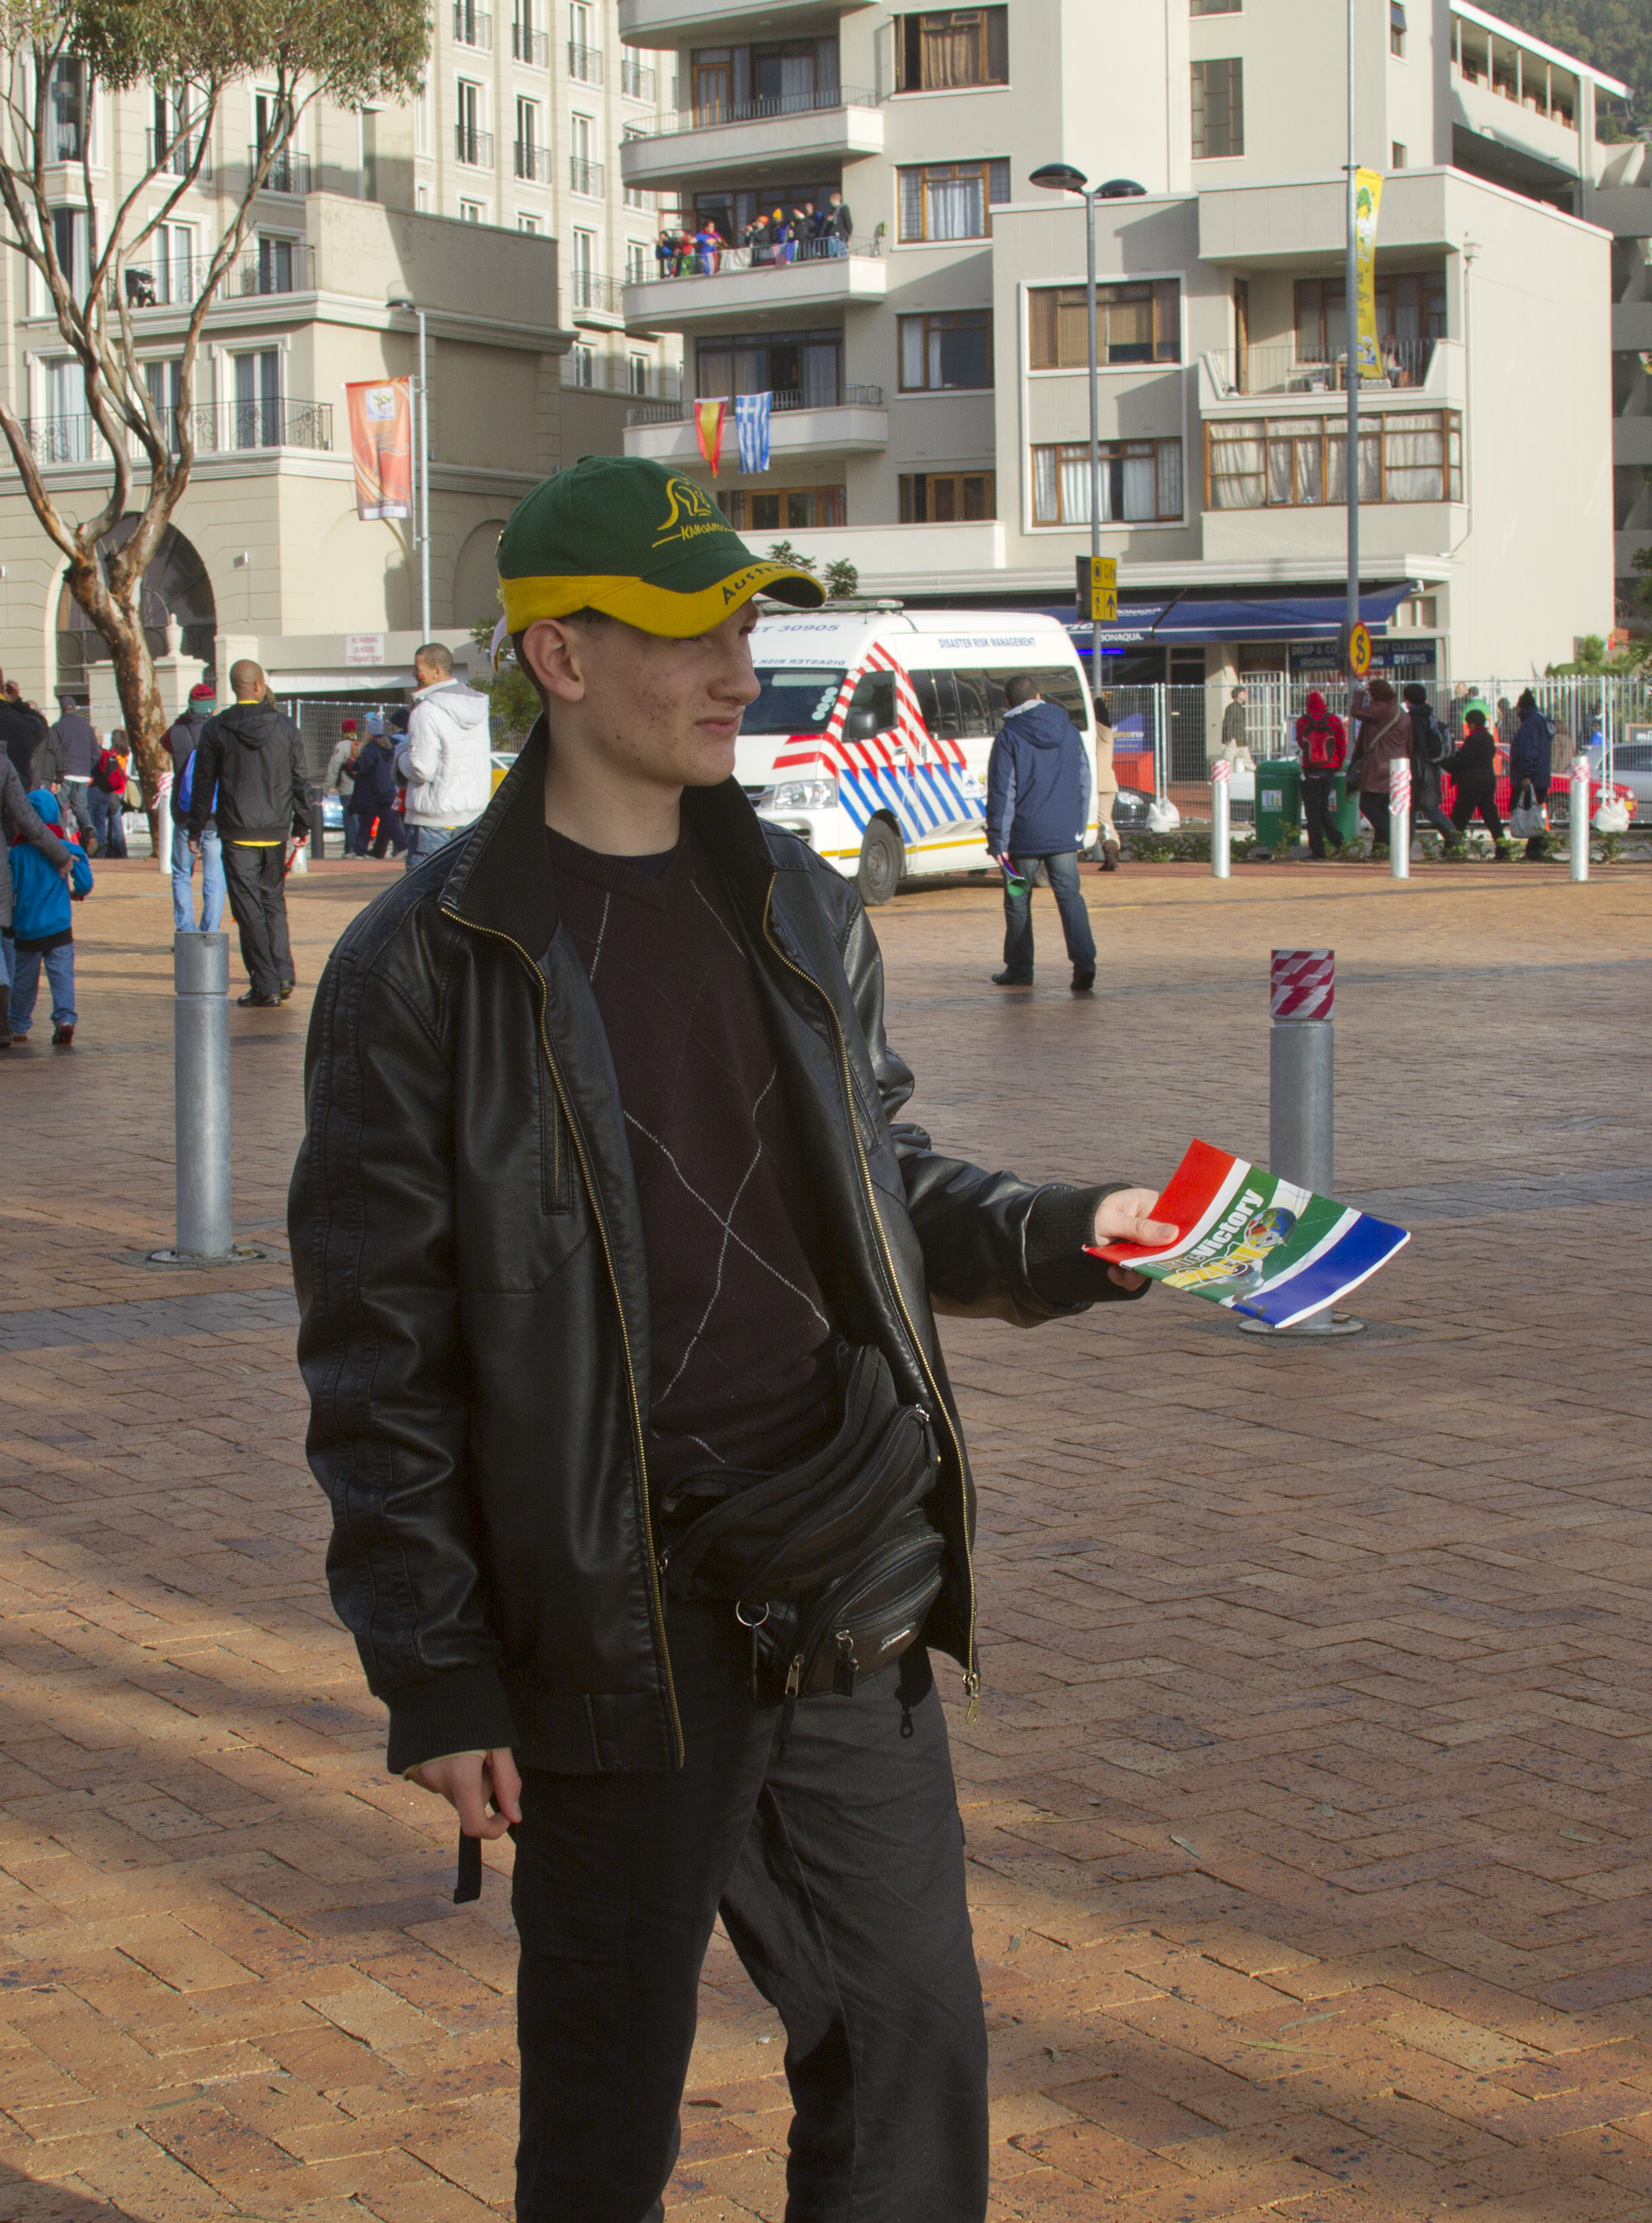
Highlights
Ease of tract distribution

Slide 9
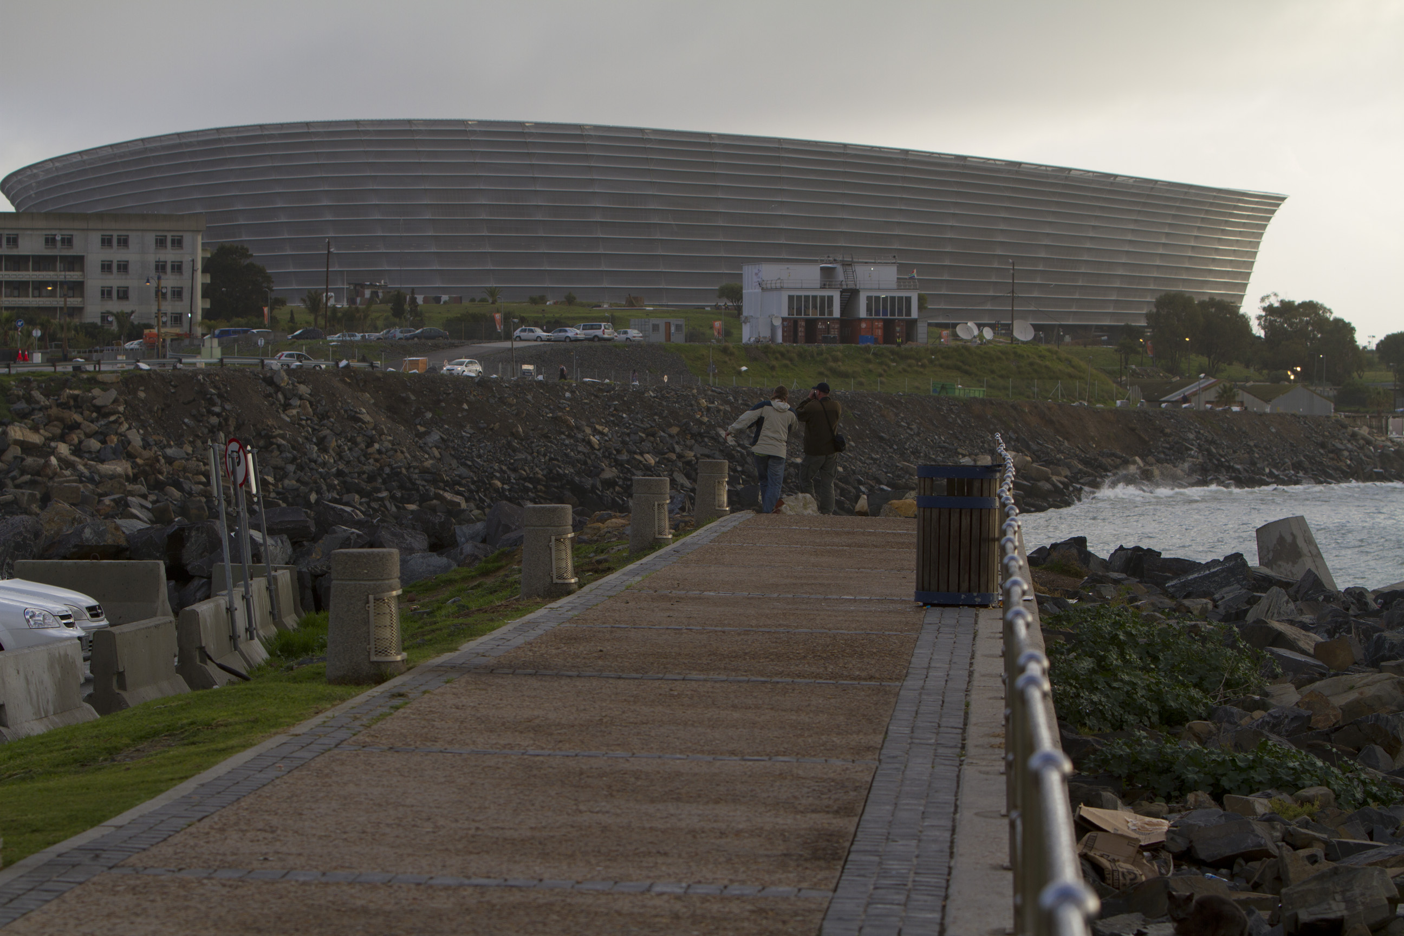
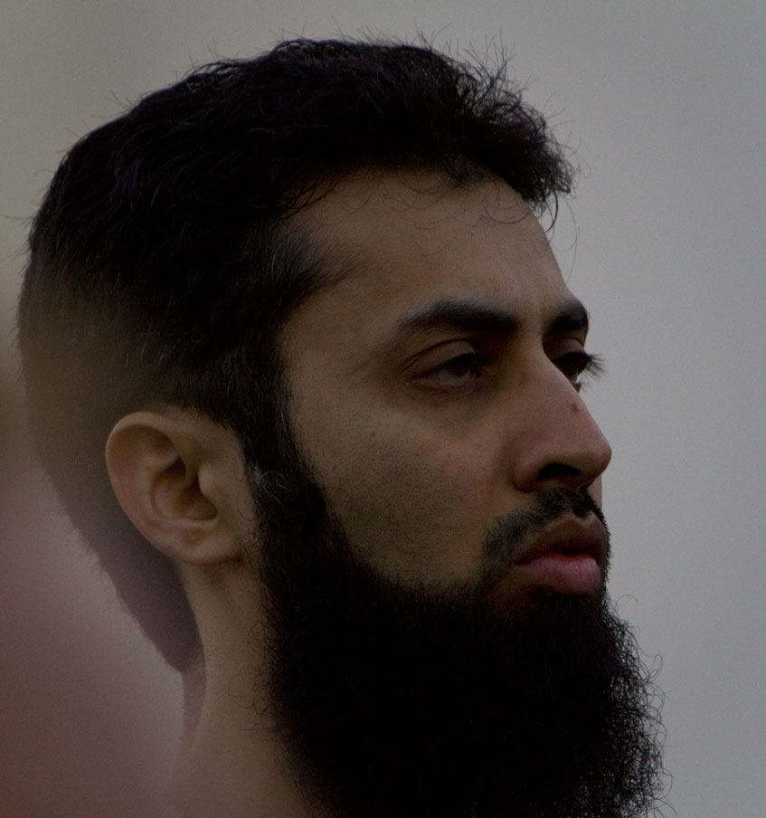
Highlights
Ease of tract distribution
Tracts in the hands of North Koreans and Muslim nations.

Slide 10
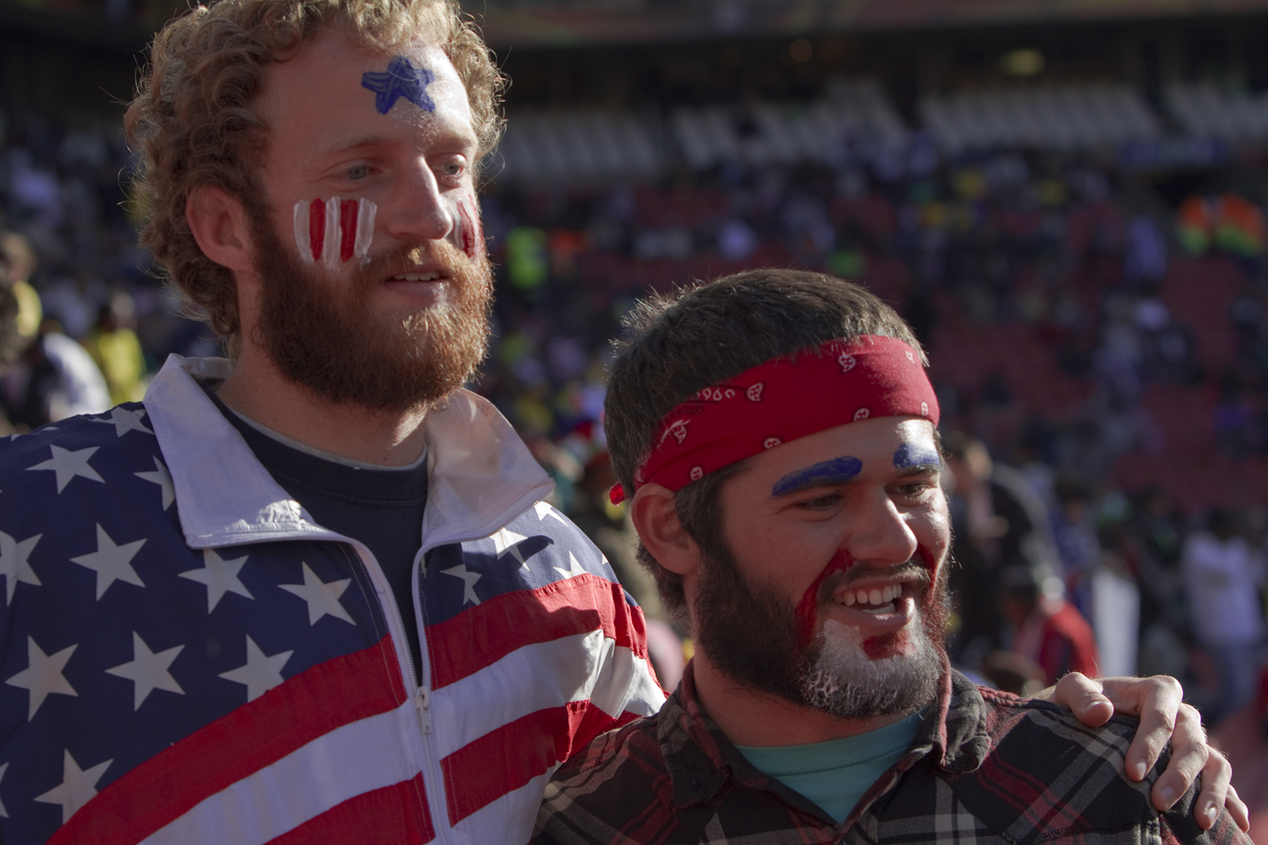
Highlights
Ease of tract distribution
Tracts in the hands of North Koreans and Muslim nations.
Cooperation with others of like precious faith

Slide 11


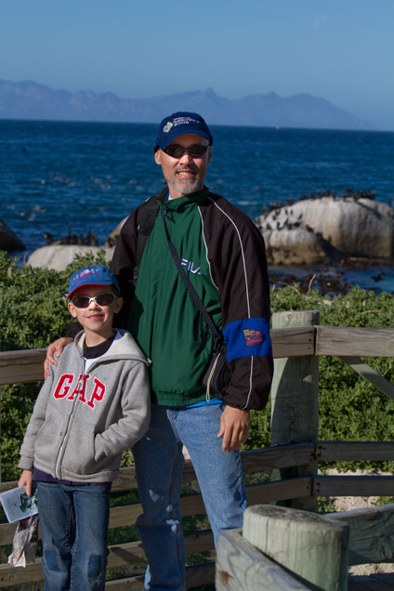
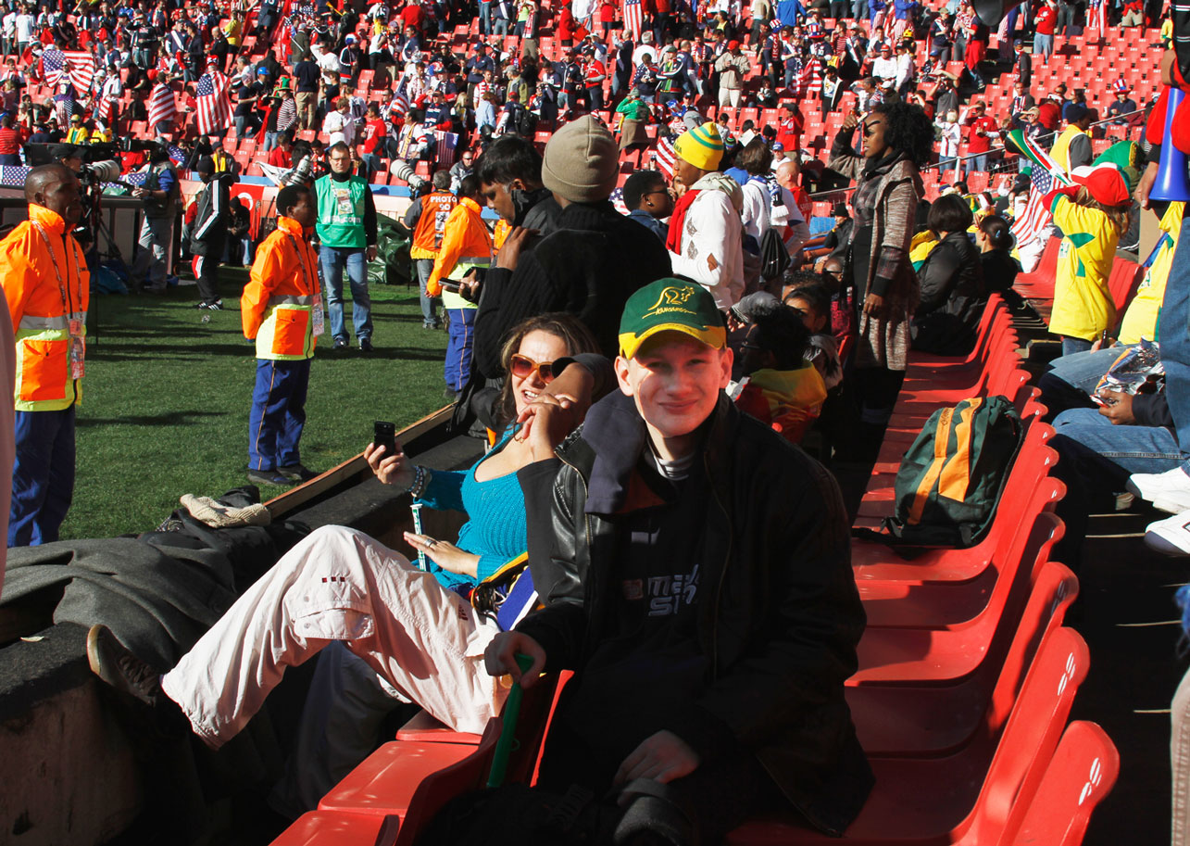
Highlights
Ease of tract distribution
Tracts in the hands of North Koreans and Muslim nations.
Cooperation with others of like precious faith
God’s blessing to us through tickets and other special opportunities

Slide 12
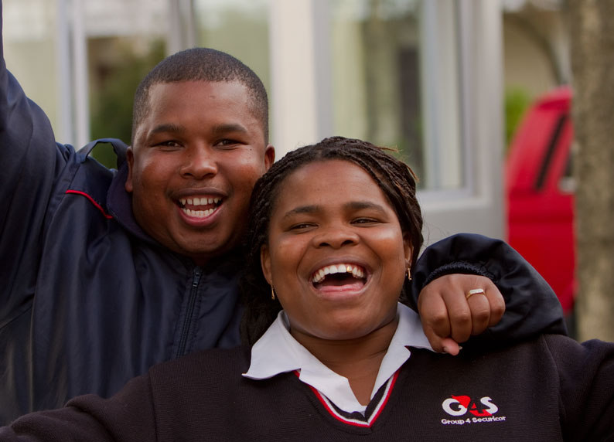
What’s Next
London Summer Olympics 2012

Slide 13
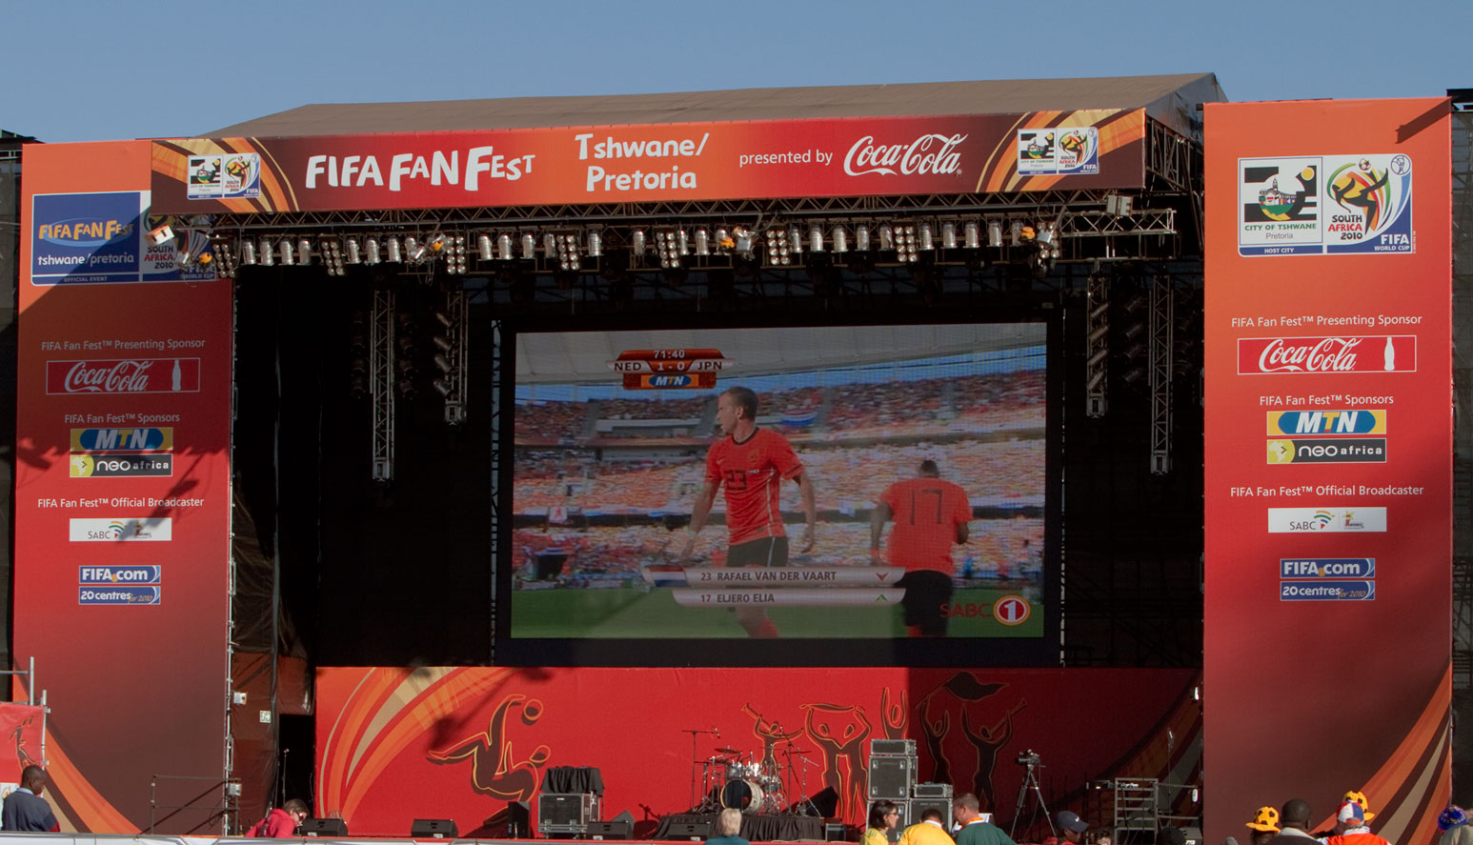
What’s Next
London Summer Olympics 2012
FIFA World Cup 2014 in Brazil

Slide 14
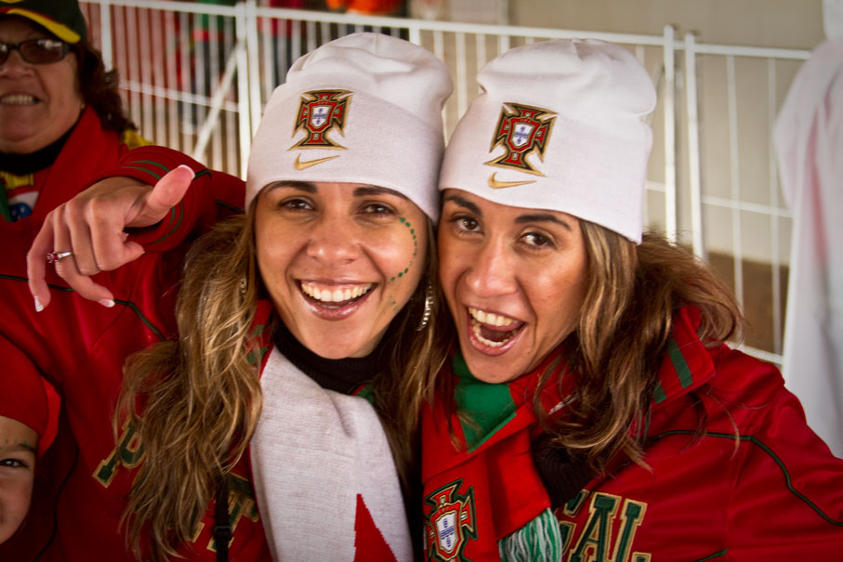
What’s Next
London Summer Olympics 2012
FIFA World Cup 2014 in Brazil
Brazil Summer Olympics 2016

Slide 15
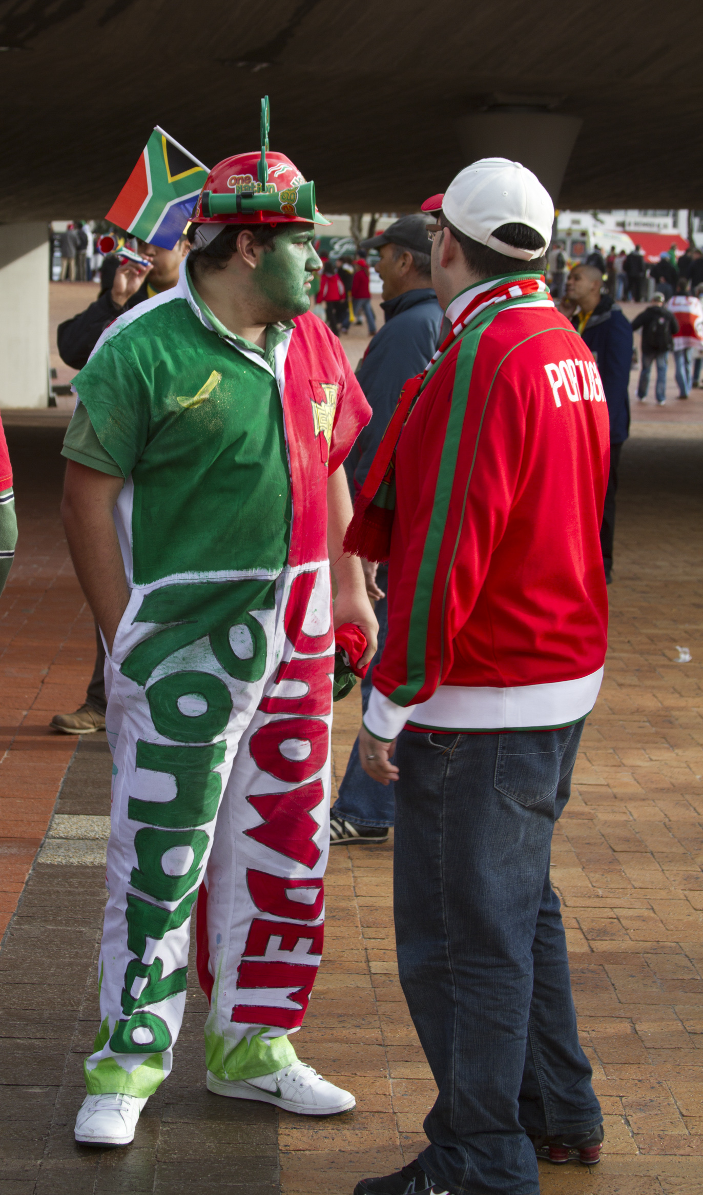
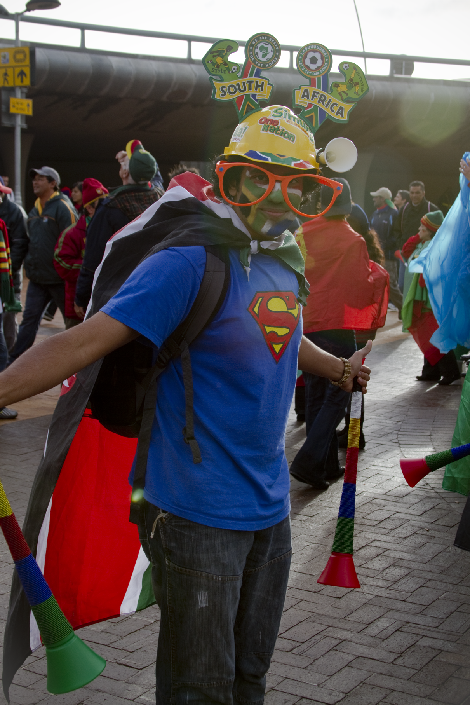
What’s Next
London Summer Olympics 2012
FIFA World Cup 2014 in Brazil
Brazil Summer Olympics 2016
Etc . . .

Slide 16
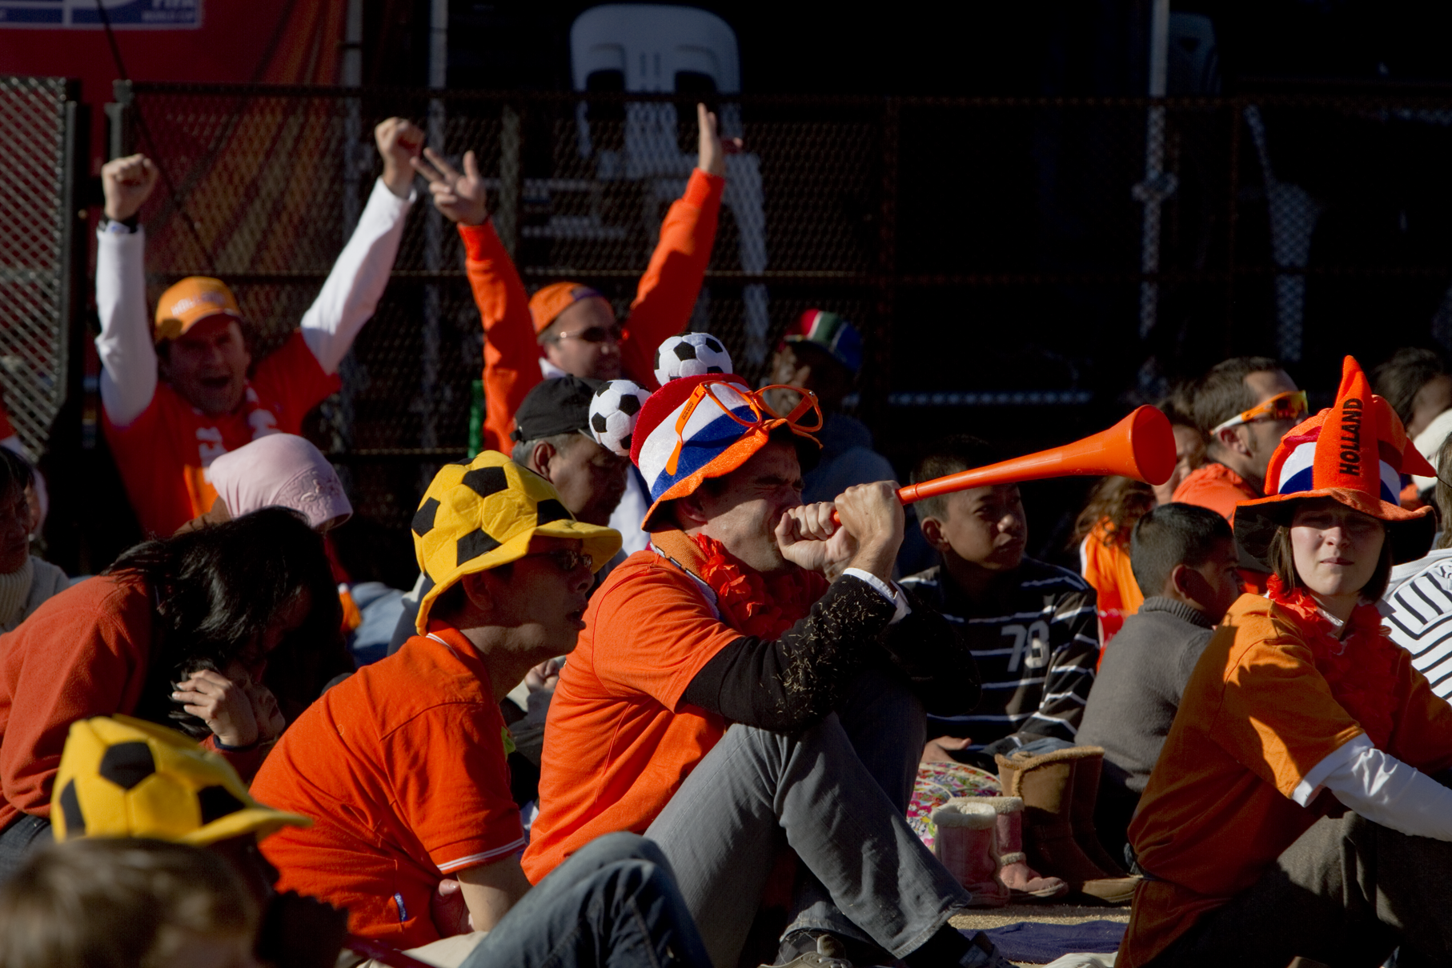
Sports Impact
When the world gets together …
Will you get involved?

